Slide 1











Official (Closed) - Non Sensitive
Programming
Fundamentals
APIs
DIPLOMA IN FULL-STACK DEVELOPMENT
Certificate in Computing Fundamentals

Slide 2
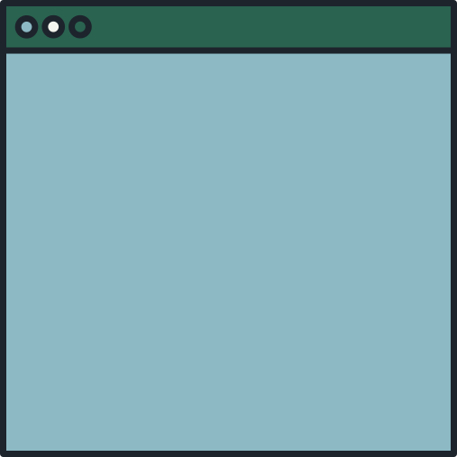

Official (Closed) - Non Sensitive
TODAY'S AGENDA
How internet works
APIs
Postman
Continuing Education & Training (CET)

Slide 3
Official (Closed) - Non Sensitive
How the
INTERNET WORKS
http protocol
Continuing Education & Training (CET)

Slide 4
Some Terminology
Official (Closed) - Non Sensitive
A website (html, js. css) etc. is hosted on a server
Server
Client
Client
Client
A software that connects to a server is known as a client
Continuing Education & Training (CET)

Slide 5
Official (Closed) - Non Sensitive
What is a Server
A server can be…
A machine that is specially built to host a website, with plenty of RAM, high-speed HDD and etc.
A software that allows other clients to connect
Continuing Education & Training (CET)

Slide 6
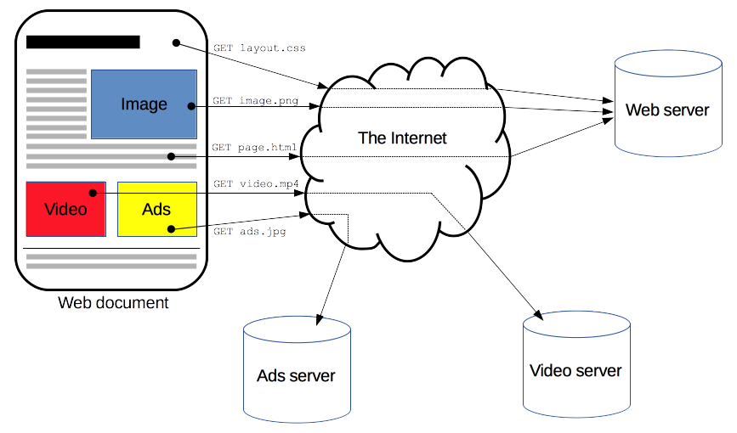
Official (Closed) - Non Sensitive
HTTP Protocol
In the context of networking, a protocol refers to how a client communicates with a server. It establishes the rules for the format of the resources that are being sent and received.
A resource here refers to data, such as a css file, html file, or image etc.
Continuing Education & Training (CET)

Slide 7
Official (Closed) - Non Sensitive
Client
Server
Router
Continuing Education & Training (CET)

Slide 8
Official (Closed) - Non Sensitive
IP Address & Web URLs
Each machine on the internet is given an IP address. We need to know the IP address of a machine access it.
However we usually access websites via URLs.
How does URLs get translated into IP addresses?
Continuing Education & Training (CET)

Slide 9
Official (Closed) - Non Sensitive
2. DNS sent back to client
Dynamic name server
1. Get the IP from the URL
DNS
5. Response is sent back
Client
Server
3. Request is sent out
4. Request is received
Router
Continuing Education & Training (CET)

Slide 10
Official (Closed) - Non Sensitive
Some HTTP Properties
The data flow is different each time
I.e, there is no persistent connection
It is stateless
State refers to data stored by the data to remember some information about the client
No state is maintained between client and server once the request is received and response is sent back.
Continuing Education & Training (CET)

Slide 11
Official (Closed) - Non Sensitive
Request & Response
Continuing Education & Training (CET)

Slide 12
Official (Closed) - Non Sensitive
Request & Response
Request ⇒ What the client sends out
Response => What the client receives from the server (i.e, what does the server sends back to the client).
Continuing Education & Training (CET)

Slide 13
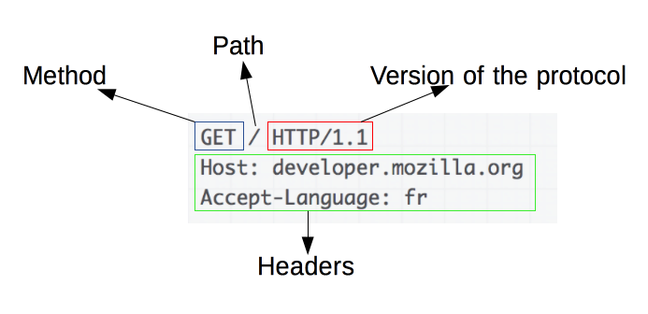
Official (Closed) - Non Sensitive
Sample Request
Continuing Education & Training (CET)

Slide 14
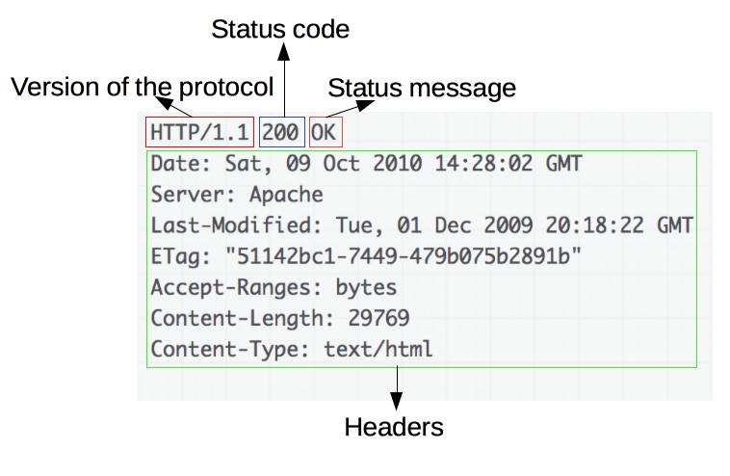
Official (Closed) - Non Sensitive
Sample Response
Continuing Education & Training (CET)

Slide 15
Official (Closed) - Non Sensitive
Sessions
Continuing Education & Training (CET)

Slide 16
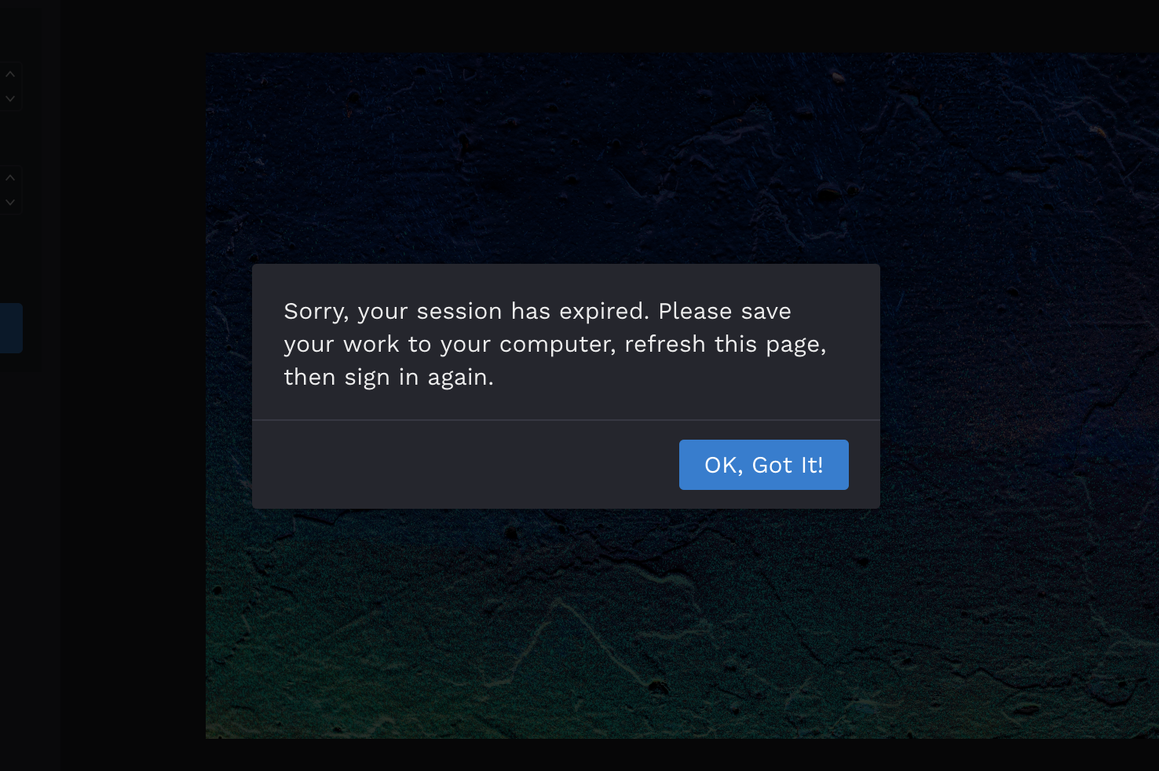
Official (Closed) - Non Sensitive
Continuing Education & Training (CET)

Slide 17
Official (Closed) - Non Sensitive
Session & Cookies
Sessions represented state stored by the server.
Every client that connects to the server has a session.
The session is stored as a file on the server.
Corresponding to each session is a cookie file
A cookie allows the client to remember about the server
Continuing Education & Training (CET)

Slide 18
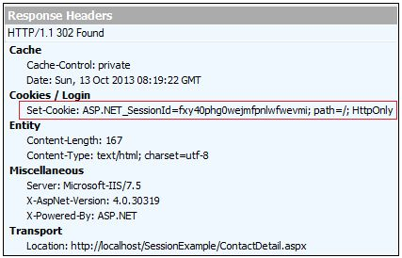
Official (Closed) - Non Sensitive
Session file
Step 1 - Client connecting for the first time. No cookies w.r.t to the server on the client
The Internet
creates
request
request
Server
Client
Step 2 - Server sends back response. Because client has never connected, it creates a session file and sends back an session_id and a session file
Continuing Education & Training (CET)

Slide 19
Official (Closed) - Non Sensitive
Step 4- Client create a cookie file that stores the IP of the server and the session id
Session file
The Internet
request
request
Server
Client
Cookie file
Continuing Education & Training (CET)

Slide 20
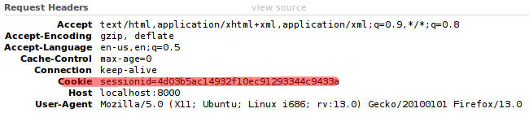
Official (Closed) - Non Sensitive
Session file
Step 5- Client, on the next request, will include the session id
The Internet
request
request
Server
Client
Cookie file
Continuing Education & Training (CET)

Slide 21
Official (Closed) - Non Sensitive
Step 6- Server will take the session id from request and check if session exists for that session id
Session file
The Internet
request
request
Server
Client
Cookie file
Continuing Education & Training (CET)

Slide 22
Official (Closed) - Non Sensitive
HTTP Status Codes
Continuing Education & Training (CET)

Slide 23

Official (Closed) - Non Sensitive
Status Code
Whenever a server sends back a response, it also associates a status code with it.
The status code indicates whether the request has been successful or not.

Slide 24
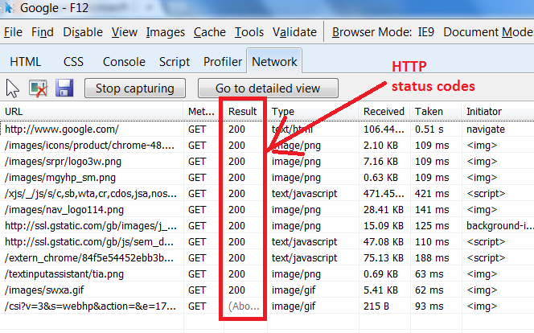
Official (Closed) - Non Sensitive
Response Code
100s - request is on-going
200s - OK
300s - redirects (trying a different URL)
400s - not found or authorization errors
500s - internal server errors (something went wrong at the server side)
https://developer.mozilla.org/en-US/docs/Web/HTTP/Status

Slide 25
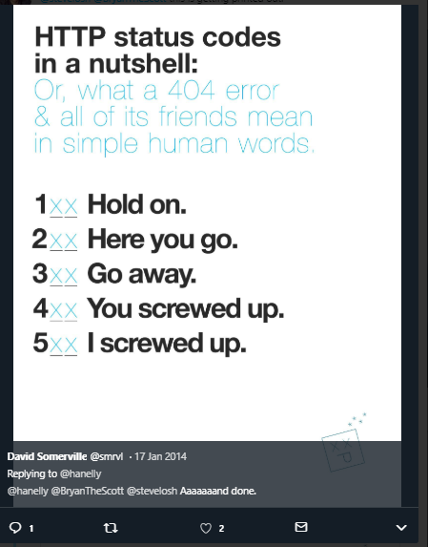
Official (Closed) - Non Sensitive
Continuing Education & Training (CET)

Slide 26
Official (Closed) - Non Sensitive
APIs and AJAX
More stuff…
Continuing Education & Training (CET)

Slide 27
Official (Closed) - Non Sensitive
Official (Closed) - Non Sensitive
Asynchronous
JavaScript
and
XML
! NOT a framework
! NOT a library
! NOT a technology
Continuing Education & Training (CET)
Notes:
Do not be confused about AJAX when you google about it. Simply put it’s a technique to retrieve data asynchronously.

Slide 28

Official (Closed) - Non Sensitive
Official (Closed) - Non Sensitive
AJAX
AJAX is a technique for loading data into part of a page without having to refresh the entire page. The data is often sent in a format called JavaScript Object Notation (or JSON)
The ability to load new content into part of a page improves the user experience because the user does not have to wait for an entire page to load if only a portion of the page is being updated.
https://replit.com/@immalcolm/ajax-examples
Continuing Education & Training (CET)
Notes:
One of the most common ways to access an API is using AJAX.
It is also used to dynamically load our pages and parts of our content.

Slide 29
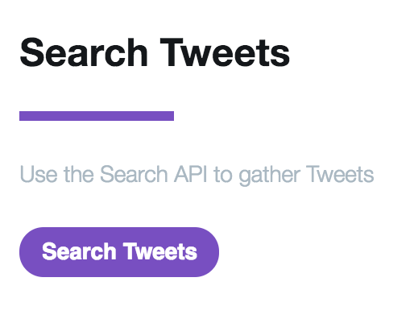
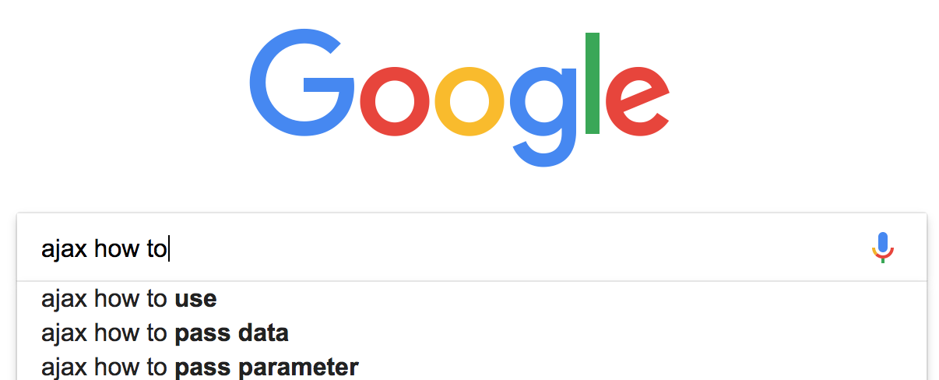
Official (Closed) - Non Sensitive
Official (Closed) - Non Sensitive
AJAX IN ACTION
Live search (or autocomplete) commonly uses Ajax. Eg. Google search. When you type into the search bar on the home page, sometimes you will see results coming up before you have finished typing
Websites with user-generated content (such as Twitter and Flickr) may allow you to display your information (such as your latest tweets or photographs) This involves collecting data from their servers or tapping on APIs
https://replit.com/@immalcolm/ajax-examples
Image Source: https://developer.twitter.com/en/docs
Continuing Education & Training (CET)
Notes:
For example when we search in Google, we see instant results coming out.
This is part of AJAX that is working behind the scenes to populate new information, by manipulating the DOM.

Slide 30
Official (Closed) - Non Sensitive
Official (Closed) - Non Sensitive
WHY USE AJAX
USING AJAX WHILE PAGES ARE LOADING
When a browser comes across a <script> tag, it will typically stop processing the rest of the page until it has loaded and processed that script. This is known as a synchronous processing model.
With AJAX, the browser can request some data from a server and once that data has been requested, continue to load the rest of the page and process the user's interactions. This is known as asynchronous (or non-blocking) processing model.
https://replit.com/@immalcolm/ajax-examples
Continuing Education & Training (CET)
Notes:
So why do we use AJAX,
JS scripts are performed using synchronous loading, meaning it’s one way.
With AJAX techniques, we can perform asynchronous loading. We can process many parts of a webpage separately.

Slide 31
Official (Closed) - Non Sensitive
Official (Closed) - Non Sensitive
WHY USE AJAX
USING AJAX WHEN PAGES HAVE LOADED
Once a page has loaded, if you want to update what the user sees in the browser, typically you would refresh the entire page. This means the user has to wait for a whole new page to download and be rendered by the browser.
With AJAX, if you only need to update a part of the page, you can just update the content of one element. This is done by intercepting an event (user clicks on link or submits a form) and requesting new content from the server via an asynchronous request.
https://replit.com/@immalcolm/ajax-examples
P2
Continuing Education & Training (CET)
Notes:
How it works?
We tell our server to update only a small part of the site.

Slide 32
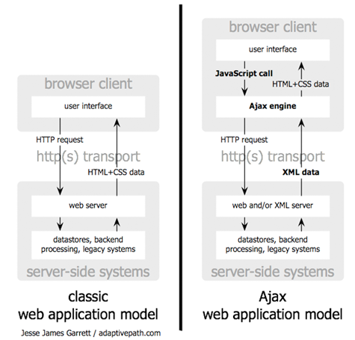
Official (Closed) - Non Sensitive
Official (Closed) - Non Sensitive
Reading Source & Image Credits: http://adaptivepath.org/ideas/ajax-new-approach-web-applications/
Continuing Education & Training (CET)
Notes:
Here’s a diagram about how AJAX works behind the scene

Slide 33
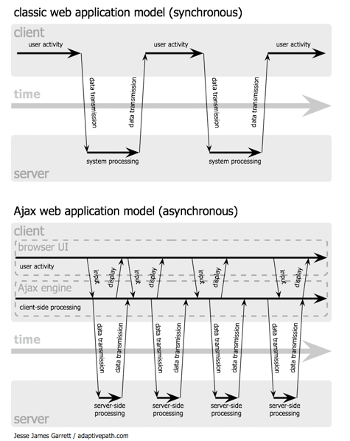
Official (Closed) - Non Sensitive
Official (Closed) - Non Sensitive
An Ajax application eliminates the start-stop-start-stop nature of interaction on the Web by introducing an intermediary — an Ajax engine — between the user and the server.
Instead of loading a webpage, at the start of the session, the browser loads an Ajax engine — written in JavaScript and usually tucked away in a hidden frame. This engine is responsible for both rendering the interface the user sees and communicating with the server on the user’s behalf.
Reading Source & Image Credits: http://adaptivepath.org/ideas/ajax-new-approach-web-applications/
Continuing Education & Training (CET)
Notes:
In the usual method we have been doing, data is retrieve synchronously. Meaning when we load a page, the system will process, then we load it.
In the AJAX model, we can load data asynchronously. Meaning we can load multiple parts of a site and change the display according to our preference.

Slide 34
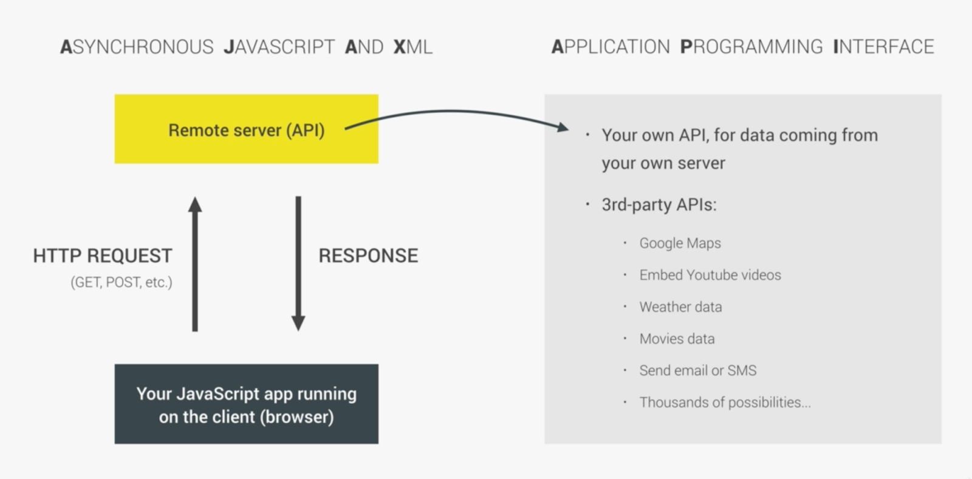
Official (Closed) - Non Sensitive
Official (Closed) - Non Sensitive
AJAX & APIs
Continuing Education & Training (CET)
Notes:
So we use AJAX and various APIs to achieve our outcomes.

Slide 35
Official (Closed) - Non Sensitive
Official (Closed) - Non Sensitive
AJAX SIMPLIFIED
Asynchronous
JavaScript
and
XML
With AJAX, websites can send and request data from a server in the background without disturbing the current page
Today's Single Page Application (SPA)
E.g; twitter, facebook, gmail, pinterest, instagram
Continuing Education & Training (CET)
Notes:
So AJAX in today’s world? It’s very common.
If you have used gmail, you probably seen new emails coming in without you refreshing your site. This is AJAX working behind the scenes.

Slide 36
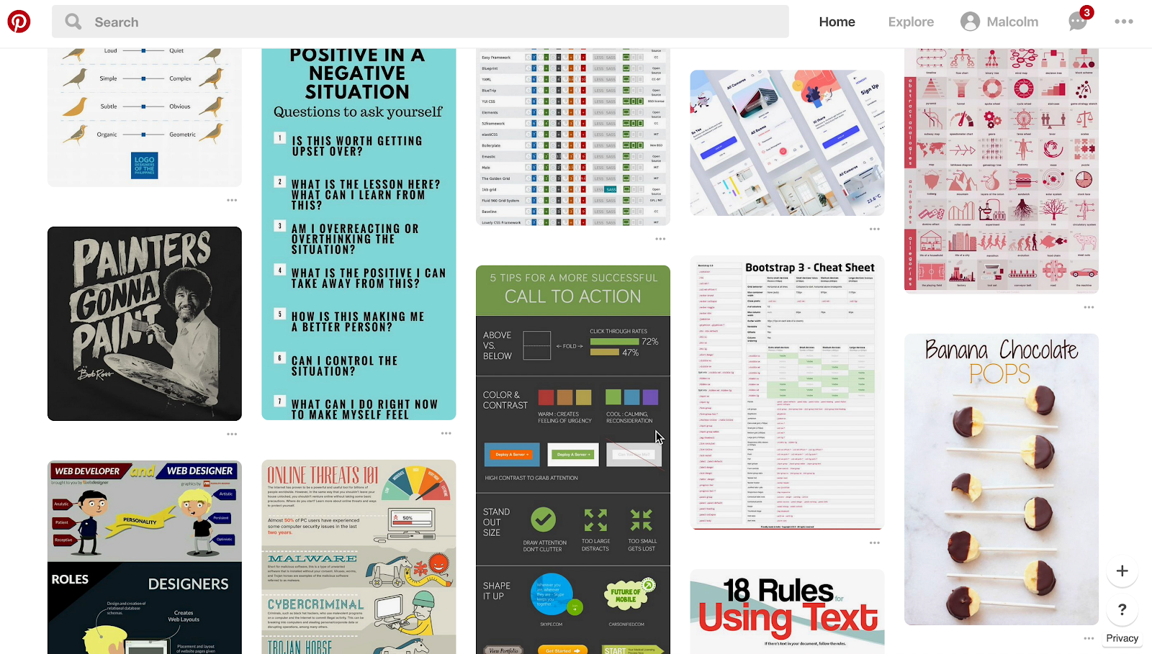

Official (Closed) - Non Sensitive
Official (Closed) - Non Sensitive
AJAX EXAMPLE
The user scrolled to the bottom
Quick, send a request to the server and get more content
Now I'll just append the new data to the bottom of the page.
SERVER
Continuing Education & Training (CET)
Notes:
Here’s an example of AJAX with pinterest lazy loading. This technique loads data asynchronously and adds new information to the bottom of the page

Slide 37
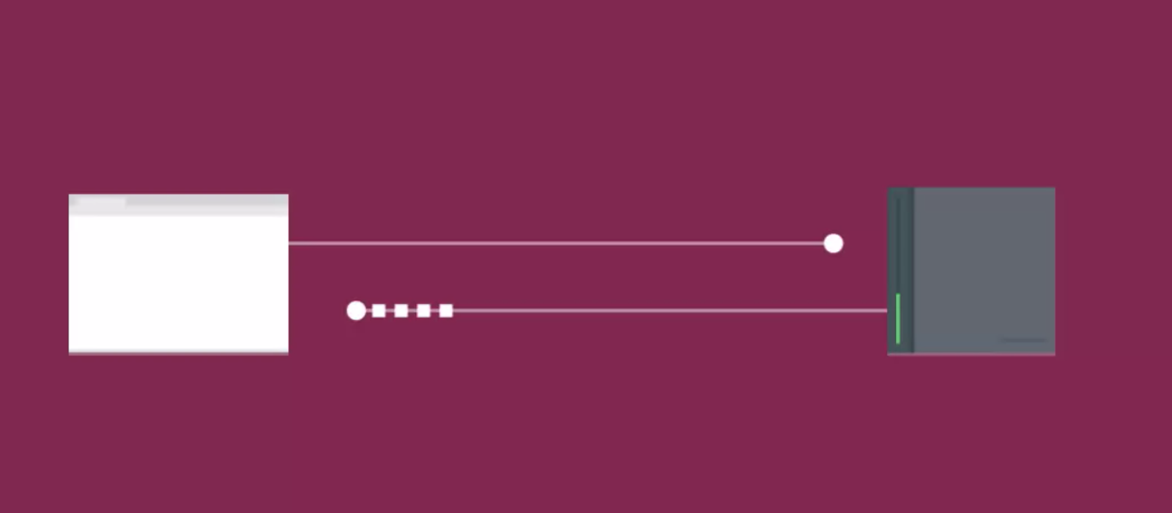
Official (Closed) - Non Sensitive
Official (Closed) - Non Sensitive
HOW AJAX WORKS
1
THE REQUEST
ON THE SERVER
The server response with data (HTML, XML, or JSON)
The browser requests information from the server.
REQUEST
RESPONSE
2
THE RESPONSE
Server
The browser processes the content and adds it to the page
AJAX lets you build webpages that ask for information from a web server. The web server returns data to the web browser, and JavaScript processes that data to selectively change parts of the web page.
The amount of data the server returns is usually much less than that sent when you ask for a full webpage.
The process of asking a server for information is technically called making a request of the server.
And when the server sends back its answer, that's called a response.
https://replit.com/@immalcolm/ajax-examples
Continuing Education & Training (CET)
Notes:
So as a client, we will send the request to the server. Once the server processes that information, we can send that response back.

Slide 38
Official (Closed) - Non Sensitive
Official (Closed) - Non Sensitive
HOW AJAX WORKS
Create an XMLHTTP Request
Create a callback function
Open a request
Send the request
This step tells the web browser to get ready.
You want to send an AJAX request and the web browser needs to create an object that has all the methods you'll need to send and receive data
This is the programming you want to run when the server returns its response. The callback is where you process the returned data and update the HTML on the page.
Browser will send the request using POST or GET
Send request to the server
https://replit.com/@immalcolm/ajax-examples
Continuing Education & Training (CET)
Notes:
The fundamental ways behind the scenes work this way.
An XMLHTTP request is created, and at the meantime you create a callback function that waits for a response.
We then open a request to the server and send it out.
Once a response is received, it is sent to the callback function.
From there, you can process or execute commands in the callback function with the requested data.
Eg. We can update the HTML page with new HTML elements.

Slide 39
Official (Closed) - Non Sensitive
Official (Closed) - Non Sensitive
DATA FORMATS
HTML
XML
JSON
Simplest way to get data from a page
Similar to HTML but tag name are different.
JavaScript Object Notation (JSON) similar syntax to literal object
BENEFITS
BENEFITS
BENEFITS
Easy to write, request and display
Data sent from the server goes straight into the page. There's no need for the browser to process it
Flexible data form and can represent complex data structures
Works well with different platforms and applications
Processed using the same DOM methods as HTML
Can be called from any domain
More concise than HTML /XML
Commonly used
DRAWBACKS
DRAWBACKS
DRAWBACKS
Server must produce the HTML in a format that is ready for use on your page
Not suited for use in applications other than web browsers. Poor data portability
Request must come from the same domain
Considered as verbose language due to the tags adding lots of extra characters
Request must come from the same domain as the rest of the page
Requires a lot of code to process the result
Syntax is not forgiving
May contain malicious content, always use from trusted sources
https://replit.com/@immalcolm/ajax-examples
Continuing Education & Training (CET)
Notes:
There are various data formats that we can play around with using AJAX but the most common and frequently used one is JSON

Slide 40
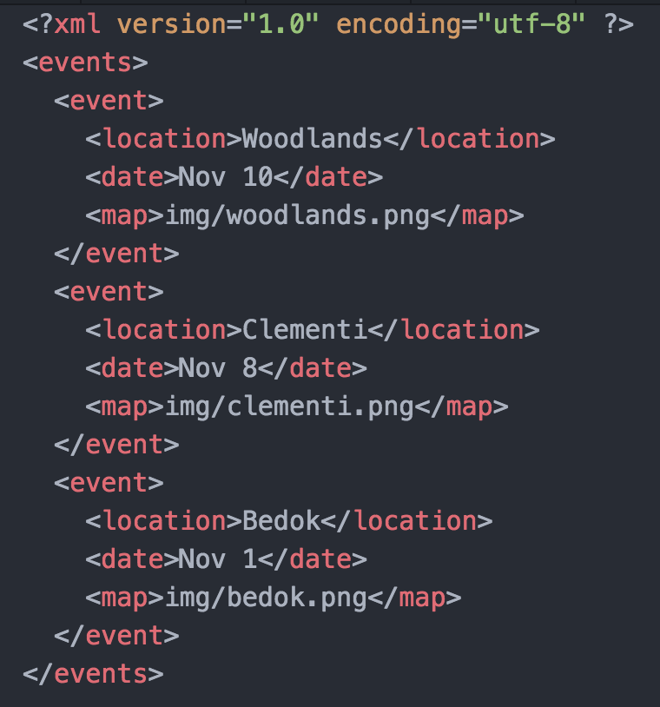
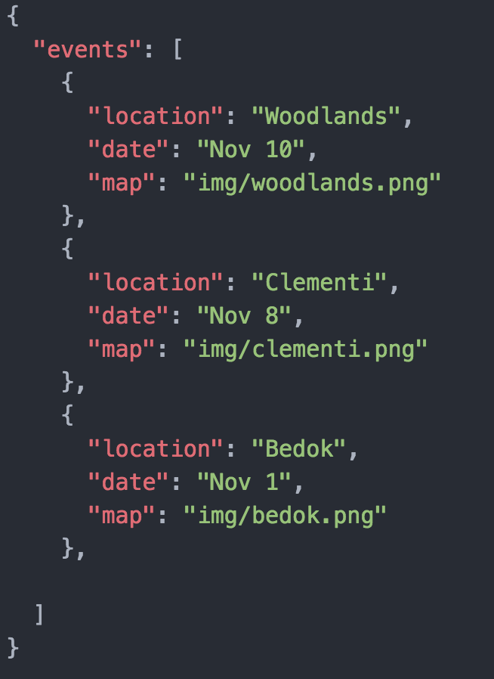
Official (Closed) - Non Sensitive
Official (Closed) - Non Sensitive
XML
JSON
https://replit.com/@immalcolm/ajax-examples
Continuing Education & Training (CET)
Notes:
In this example, JSON is much simpler to understand.
XML has custom tags and gets tedious to process.

Slide 41
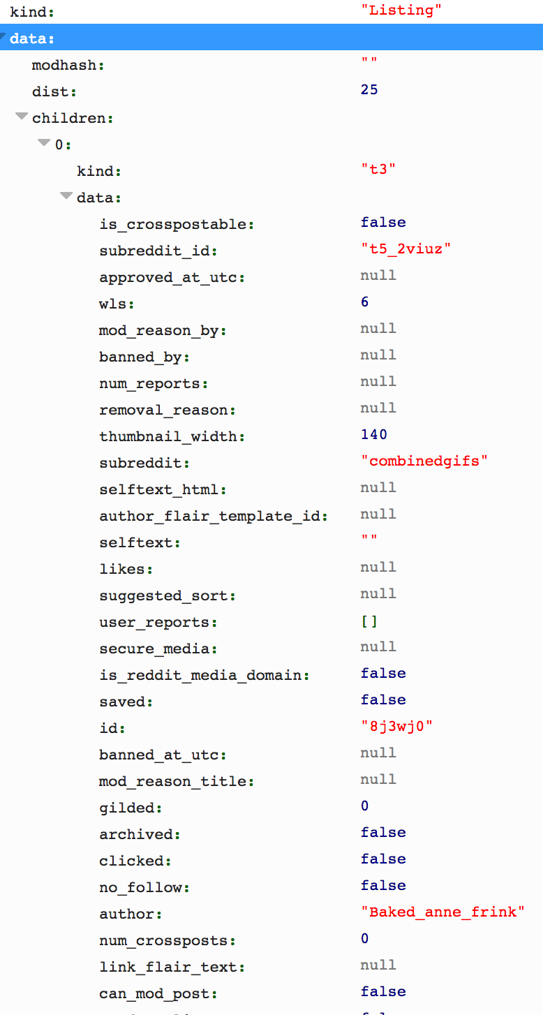
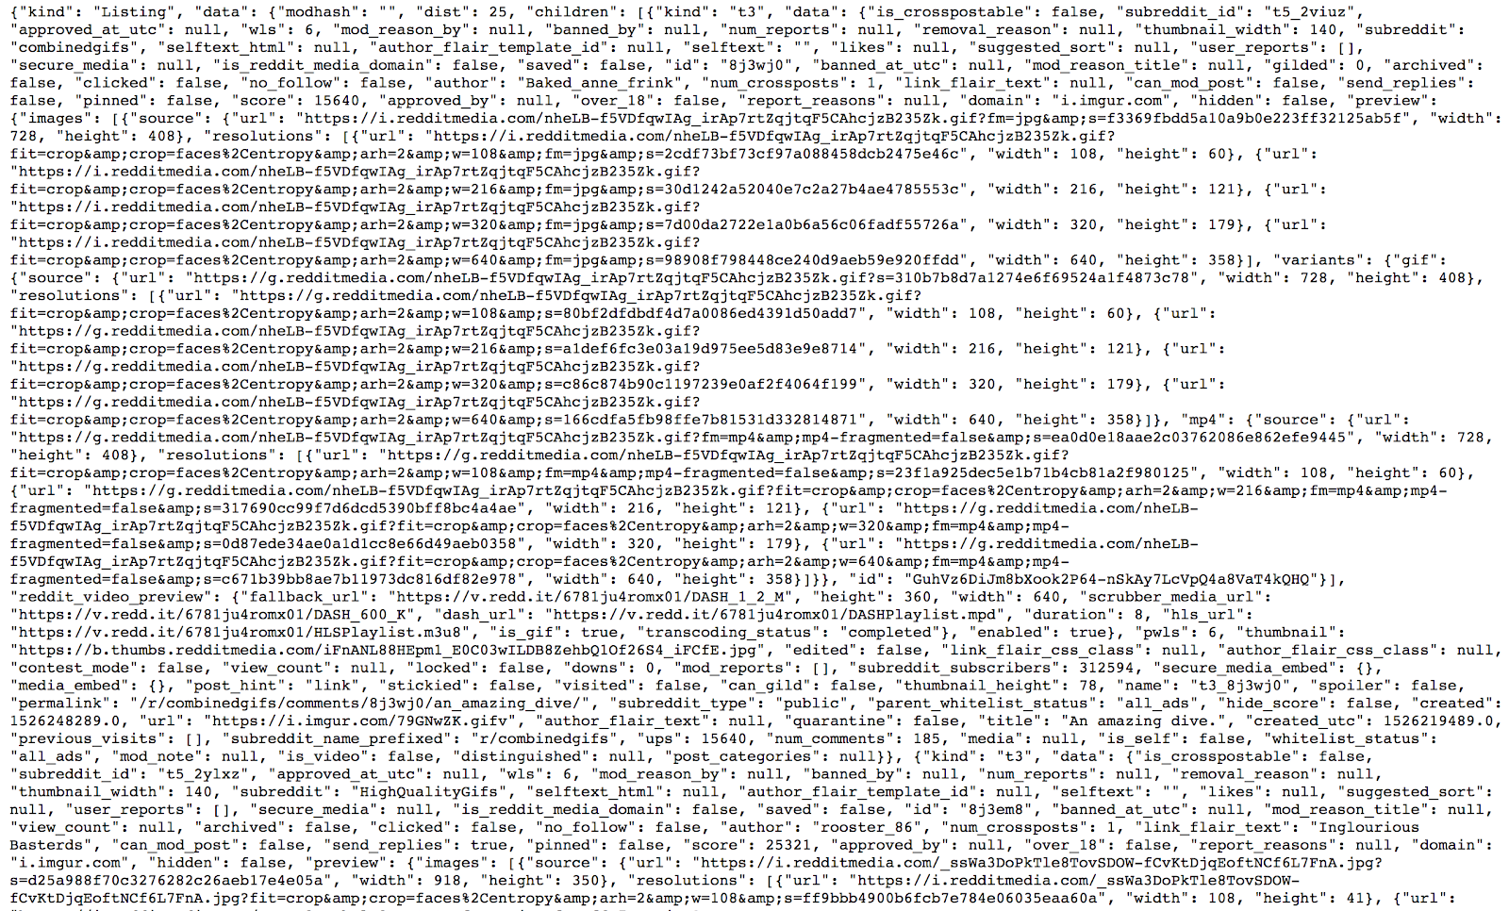
Official (Closed) - Non Sensitive
Official (Closed) - Non Sensitive
SAMPLE JSON FROM REDDIT
Sample Data: https://www.reddit.com/.json
Continuing Education & Training (CET)
Notes:
Reddit has open json data we can access.

Slide 42
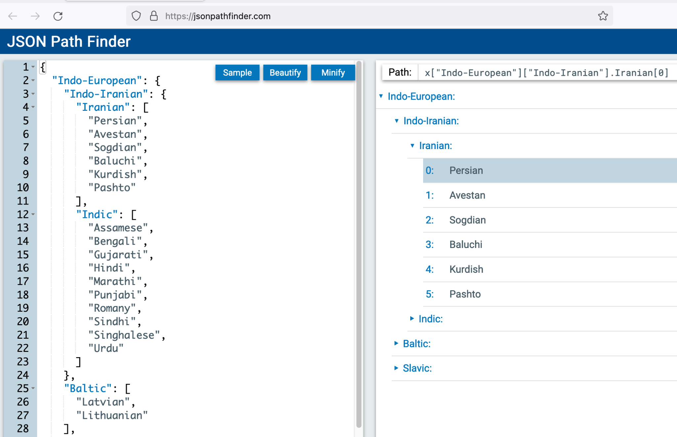
Official (Closed) - Non Sensitive
🕔 Understanding JSON & Pathing
https://jsonpathfinder.com/
Getting stuck or confused with array and object mapping or finding the index?
JSON Path Finder is a great utility to better visualise how pathing works in a JSON
Continuing Education & Training (CET)

Slide 43
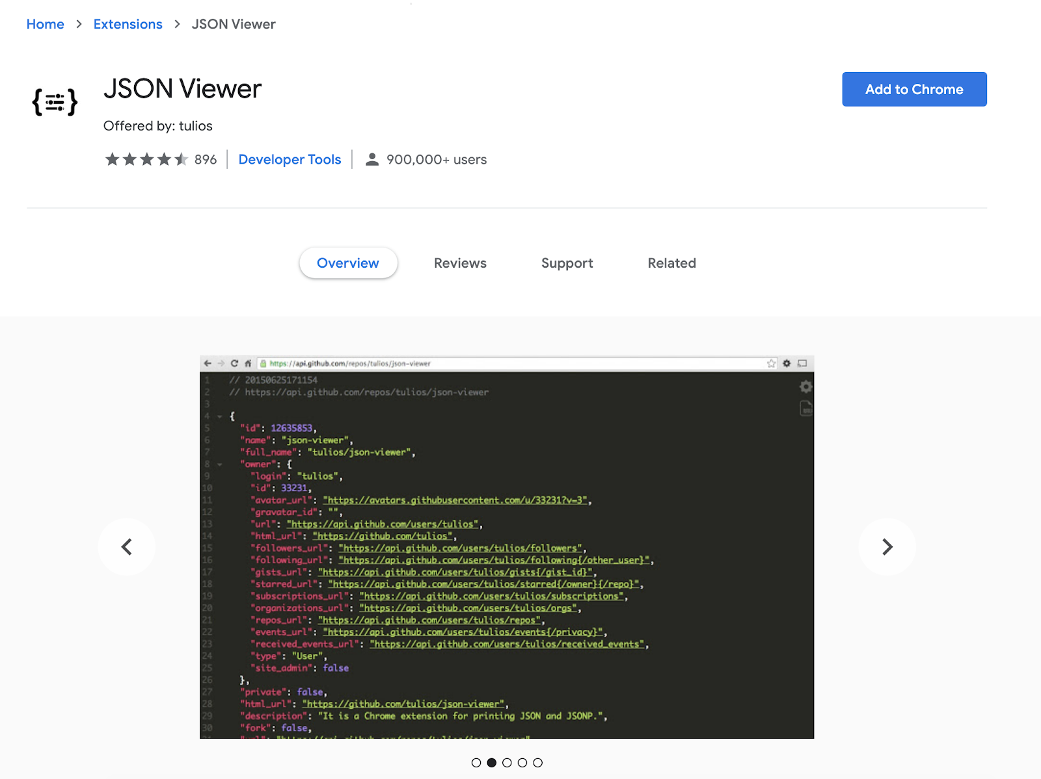
Official (Closed) - Non Sensitive
Official (Closed) - Non Sensitive
JSON Toolkit
Chrome Extension JSON Viewer
http://jsonviewer.stack.hu/
Download JSON Viewer Extensions
https://chrome.google.com/webstore/detail/json-viewer/gbmdgpbipfallnflgajpaliibnhdgobh
Continuing Education & Training (CET)
Notes:
This is a great chrome extension to view your JSON data easier
https://chrome.google.com/webstore/detail/json-viewer/gbmdgpbipfallnflgajpaliibnhdgobh
http://jsonviewer.stack.hu/

Slide 44
Official (Closed) - Non Sensitive
Official (Closed) - Non Sensitive
Making Requests with JavaScript
XMLHTTP Request
Fetch API
3rd Party Libraries, jQuery
Continuing Education & Training (CET)
Notes:
There are a few ways we can apply the AJAX technique.
Traditional way is the XMLHTTP request which is very long
Using the new Javascript FETCH API
We can use jquery ajax methods to simplify our coding too.

Slide 45
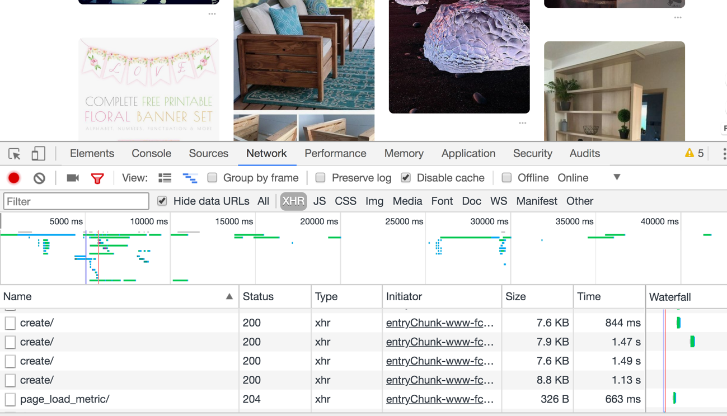
Official (Closed) - Non Sensitive
Official (Closed) - Non Sensitive
XHR Requests OK
Every request, makes an xhr request.
Continuing Education & Training (CET)
Notes:
We can view our AJAX requests by referencing XHR under Network tools

Slide 46
Official (Closed) - Non Sensitive
Official (Closed) - Non Sensitive
BASIC AJAX REQUEST
var XHR = new XMLHttpRequest();
XHR.onreadystatechange = function(){
if(XHR.readyState == 4 && XHR.status == 200){
console.log(XHR.responseText);
}
};
XHR.open("GET", "https://api.github.com/zen");
XHR.send();
Continuing Education & Training (CET)
Notes:
This can get tedious if you have multiple AJAX requests

Slide 47
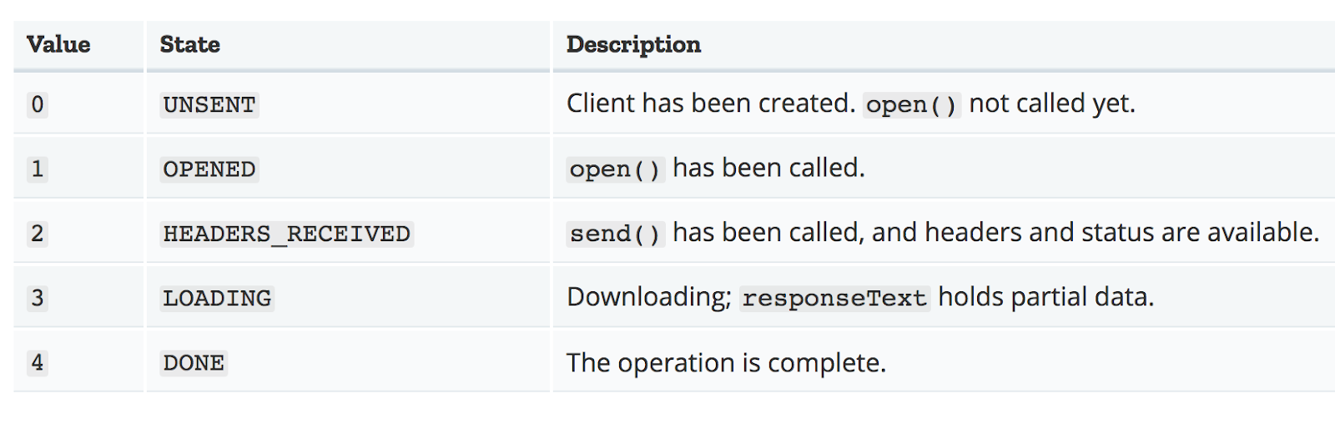
Official (Closed) - Non Sensitive
Official (Closed) - Non Sensitive
Reading Material: https://developer.mozilla.org/en-US/docs/Web/API/XMLHttpRequest/readyState
Continuing Education & Training (CET)
Notes:
The XMLHTTP requests have 5 main states.
https://developer.mozilla.org/en-US/docs/Web/API/XMLHttpRequest/readyState

Slide 48
Official (Closed) - Non Sensitive
PROBLEMS WITH XHR
Ugly, bulky syntax
Very old method
No streaming allowed. Issue when large amounts of data comes in
Continuing Education & Training (CET)

Slide 49
Official (Closed) - Non Sensitive
API
Connecting with others
Application Interface Programming
Continuing Education & Training (CET)

Slide 50

Official (Closed) - Non Sensitive
Official (Closed) - Non Sensitive
#THEWAITER
What does he do?
Continuing Education & Training (CET)
Notes:
Imagine you go to a restaraunt.
The waiter takes your order. And goes to the kitchen with your order.
You have no idea how your meal is cooked.
The waiter comes back with your awesome meal.
Basically APIs work in this manner.
We provide information to an API and that API will somehow process your information together with its system/code and return the correct results to you.

Slide 51

Official (Closed) - Non Sensitive
Official (Closed) - Non Sensitive
Mulesoft: What is an API
https://www.youtube.com/watch?v=s7wmiS2mSXY
Continuing Education & Training (CET)
Notes:
Check out this great video on how APIs work
https://www.youtube.com/watch?v=s7wmiS2mSXY

Slide 52
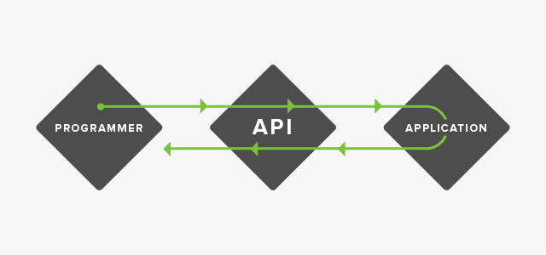
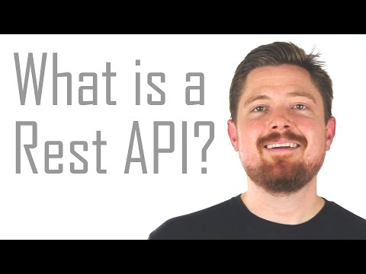
Official (Closed) - Non Sensitive
Official (Closed) - Non Sensitive
Take a request
Deliver it
Bring back a response
Source: http://sproutsocial.com/insights/what-is-an-api/
Continuing Education & Training (CET)
Notes:
So as we break it down to a chart this is how an APi can look like.
The programmer sends information to the API, and the API processes it on their end.
They then send it back to the programmer.

Slide 53

Official (Closed) - Non Sensitive
Official (Closed) - Non Sensitive
Web Developers
Additional functionality and features to be integrated into the websites
Customisation, Flexibility, Mashups
Quicker, Faster (less complexity)
End Users
A good Web API can help increase the usefulness of a website and make the site interactive and more enjoyable..
Continuing Education & Training (CET)
Notes:
As web developers we are constantly stressed for time to build complex applications.
We can tap onto useful APIs and create a better and more powerful application and we can cater more time to creating better user experiences.

Slide 54
With API: An app finds the current weather in London by sending a message to the weather.com API (in a structured format like JSON). The weather.com API then replies with a structured response.
Official (Closed) - Non Sensitive
Without API: An app finds the current weather in London by opening
http://www.weather.com/ and reading the webpage like a human does, interpreting the content.
Reading Reference: https://www.quora.com/What-is-an-API-4
Continuing Education & Training (CET)
Notes:
Without an API, finding out the weather will be tough. We can’t actually build the weather system.
With an API, we can do just that. We let the weather handling be done by the API, and we tell our API a question say what’s the weather today.
Our API will receive the request and process that information. It will then send back a response whether it is successful or unsuccessful with the appropriate result set.

Slide 55
Official (Closed) - Non Sensitive
Accessing API
Connecting with others
Application Interface Programming
Continuing Education & Training (CET)

Slide 56
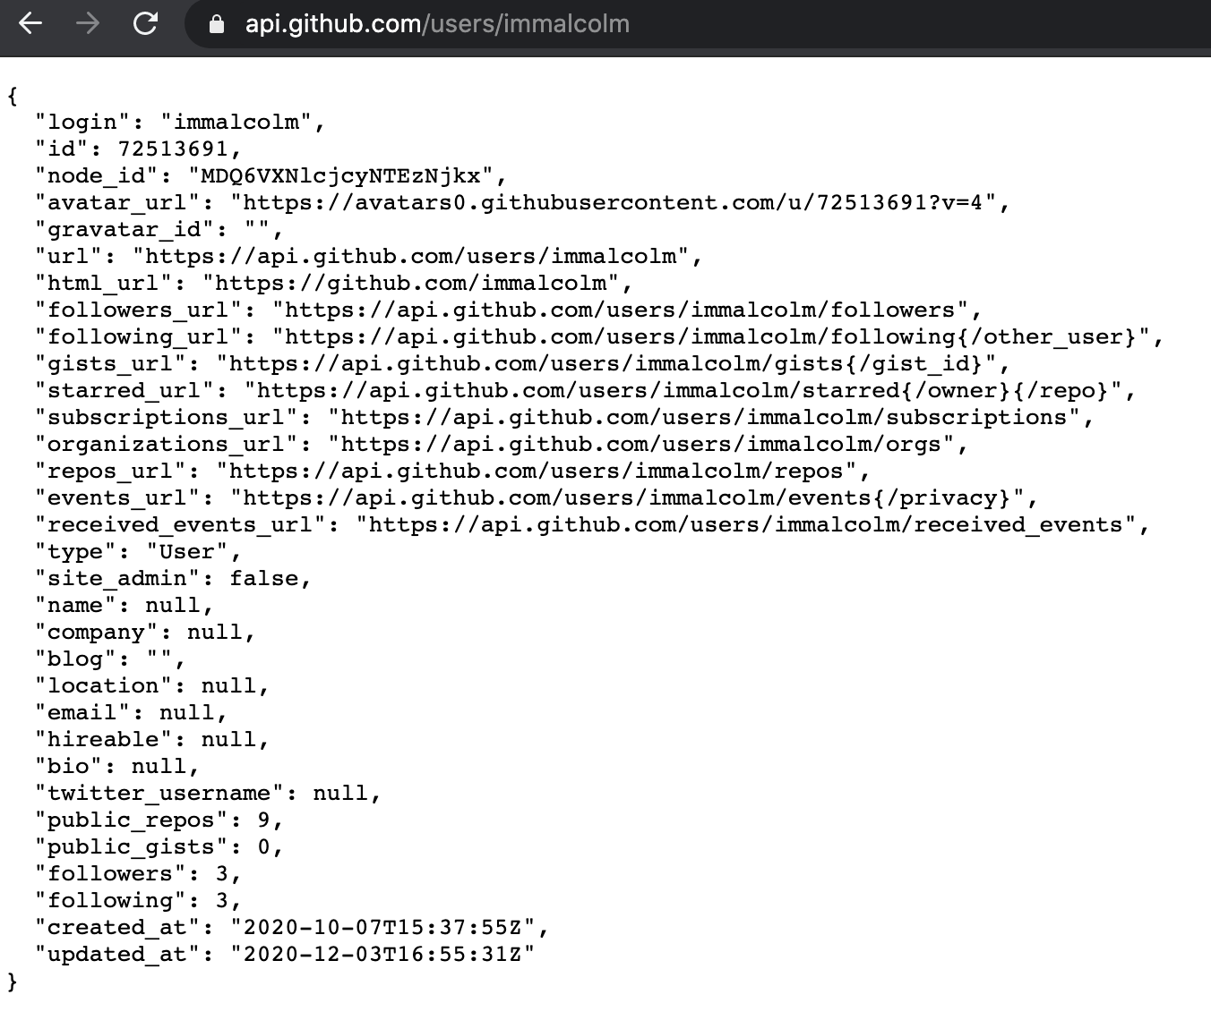
Official (Closed) - Non Sensitive
Testing out API & JSON
We can try out the Github API by simply entering the github api url and our username
This API returns all the public information regarding the user.
Try it out on your own!
What gets returned is JSON string data. So we will need to call JSON.parse(data) to convert our JSON data into Javascript Objects.
Example of data stored into a data object using JSON.parse
https://replit.com/@immalcolm/simple-githubjson#script.js
https://api.github.com/users/immalcolm
Continuing Education & Training (CET)
Notes:
Here’s an example of the Github api with JSON data being shown
https://api.github.com/users/immalcolm

Slide 57

Official (Closed) - Non Sensitive
Postman makes API development faster, easier, and better
Highly used
Intuitive user interface to send requests, save responses, add tests, and create workflows
https://www.postman.com/downloads/
P O S T M A N
Source: https://www.getpostman.com/
Continuing Education & Training (CET)
Notes:
Commonly referred as fetching data from an API and displaying it.
The earlier Github example is an example of fetching data from the Github API
Let’s install POSTMAN to test APIs out real quick

Slide 58
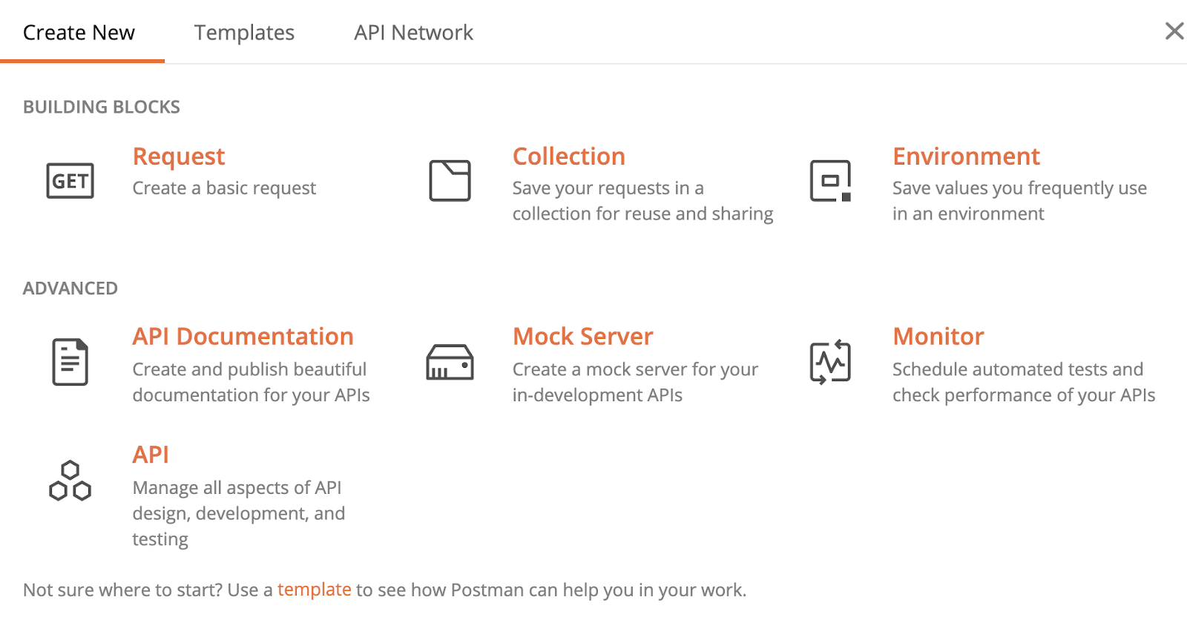
Official (Closed) - Non Sensitive
Continuing Education & Training (CET)
Notes:
First we setup our request. In most instances, we are basically requesting information. So select Request

Slide 59
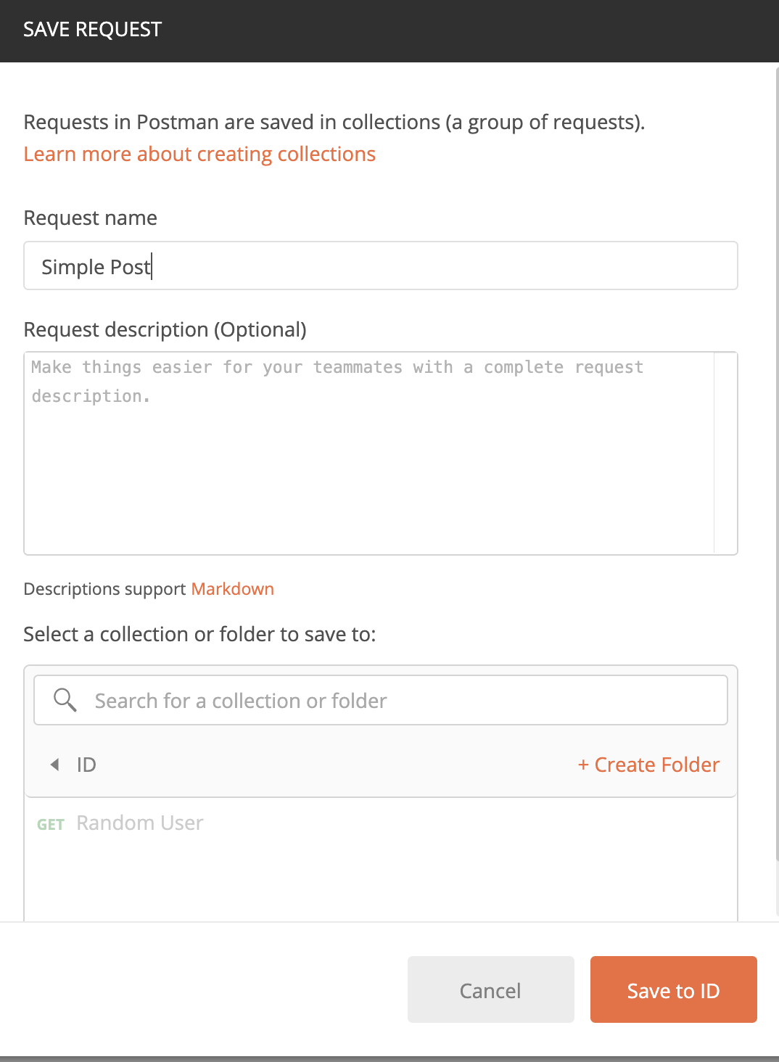
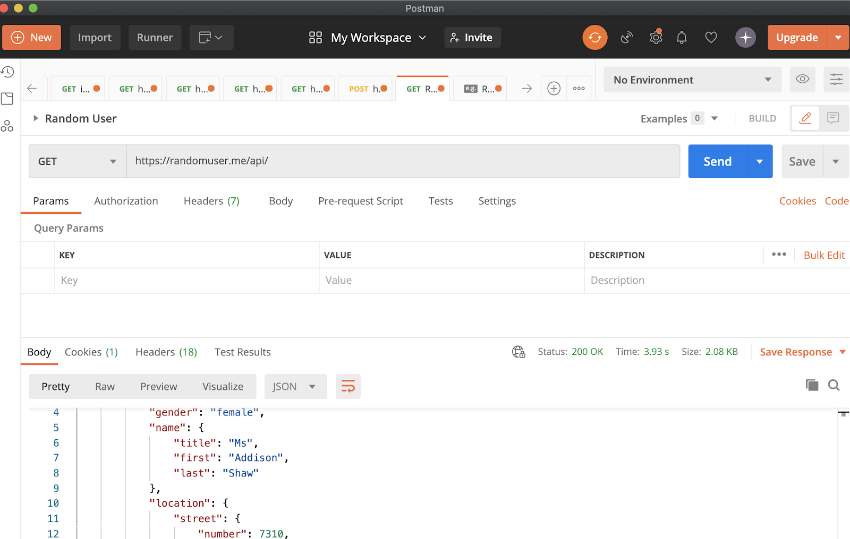
Official (Closed) - Non Sensitive
Enter your request name
Enter your API url
Save the info to a collection
Results that come back
Continuing Education & Training (CET)
Notes:
Next we have to save our request information first.
Simply enter a request name related to your query.
Then save it to your collection or create a new collection
Then you will be greeted with the POSTman interface.
Enter the URL you want to query and click on send
There are several other paramters you might have to key in depending on the API, but in this instance we do not need to bother.
You will see a long chunk of JSON information. This is the end result that is coming back

Slide 60
Official (Closed) - Non Sensitive
ACTIVITY
“FIRST API REQUEST” (10mins)
#TODO
Download POSTMAN from http://getpostman.com
Follow instructions from your tutor
Resource: https://ipapi.co/
Create a GET request to https://ipapi.co/json to retrieve your IP address + location
Continuing Education & Training (CET)
Notes:
Let’s try this example together with the class.

Slide 61
Official (Closed) - Non Sensitive
Fetch
Continuing Education & Training (CET)

Slide 62
Official (Closed) - Non Sensitive
FETCH
FETCH with Options
fetch(url)
.then(function(res){
console.log(res);
})
.catch(function(error){
console.log(error);
})
fetch(url, {
method: 'POST',
body: JSON.stringify({
name: 'red',
login: 'redmonster',
})
})
.then(function (data) {
//return data.json();
//do something
})
.then(function (data) {
//process the return earlier
}).
.catch(function (error){
//handle error
})
https://developer.mozilla.org/en-US/docs/Web/API/Fetch_API/Using_Fetch
Continuing Education & Training (CET)
Continuing Education & Training (CET)
Notes:
Let’s introduce the fetch method
In this fetch method, we send a URL over and some data
Then we wait for data to be return to us. Fetch in this sense returns for a “promise”.

Slide 63
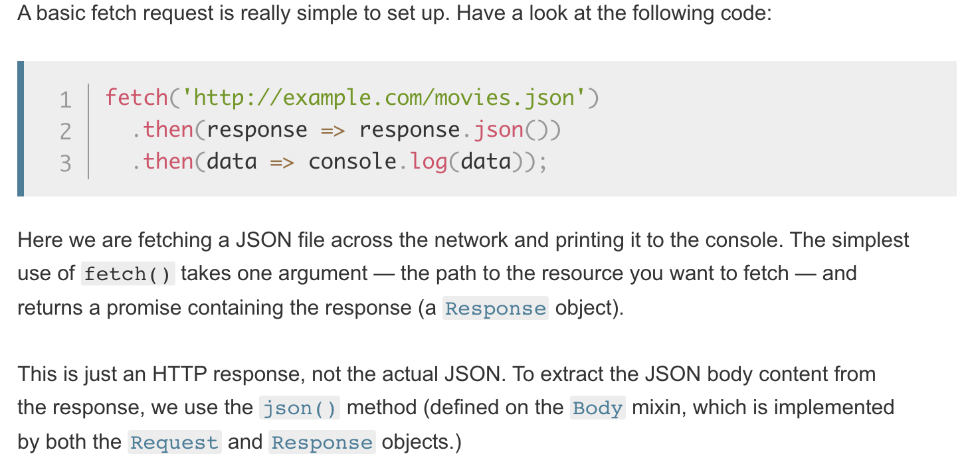
Official (Closed) - Non Sensitive
FETCH
Continuing Education & Training (CET)

Slide 64
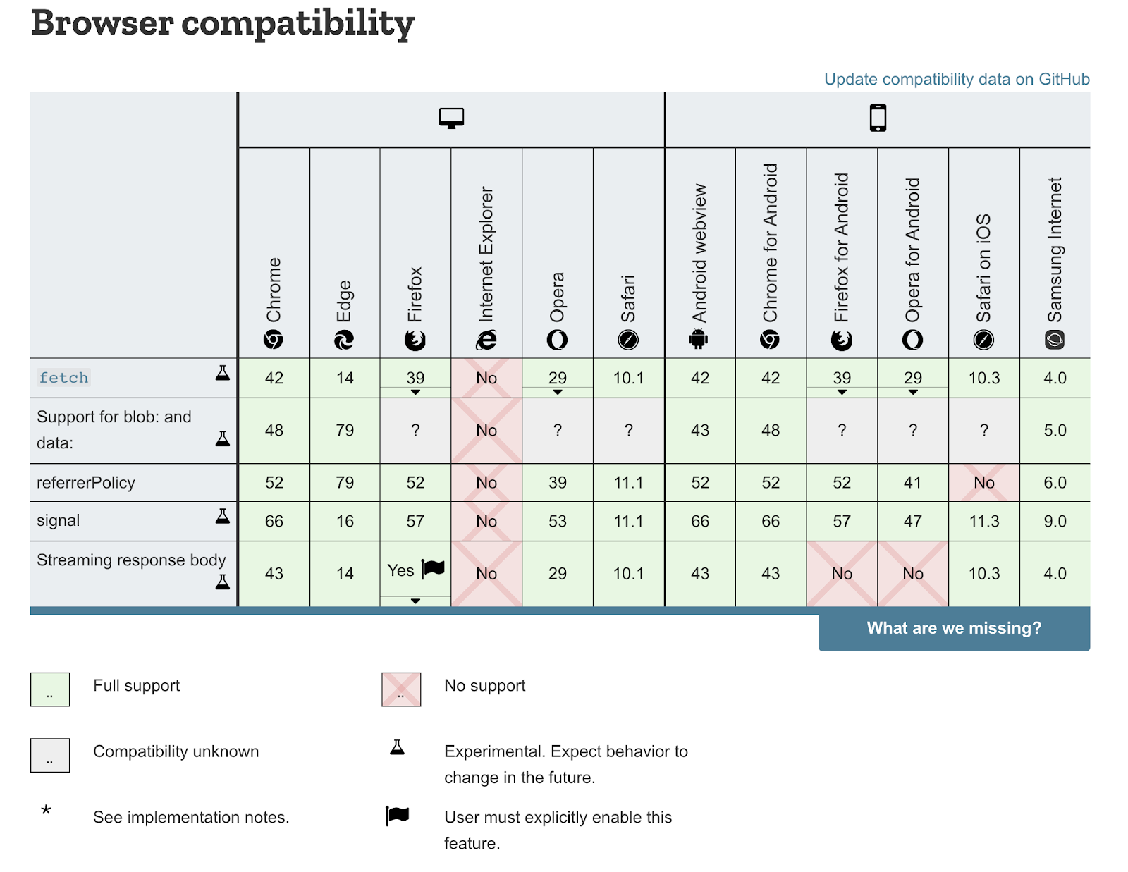
Official (Closed) - Non Sensitive
FETCH BROWSER SUPPORT
I
Reading & Source: https://developer.mozilla.org/en-US/docs/Web/API/Fetch_API
Continuing Education & Training (CET)

Slide 65
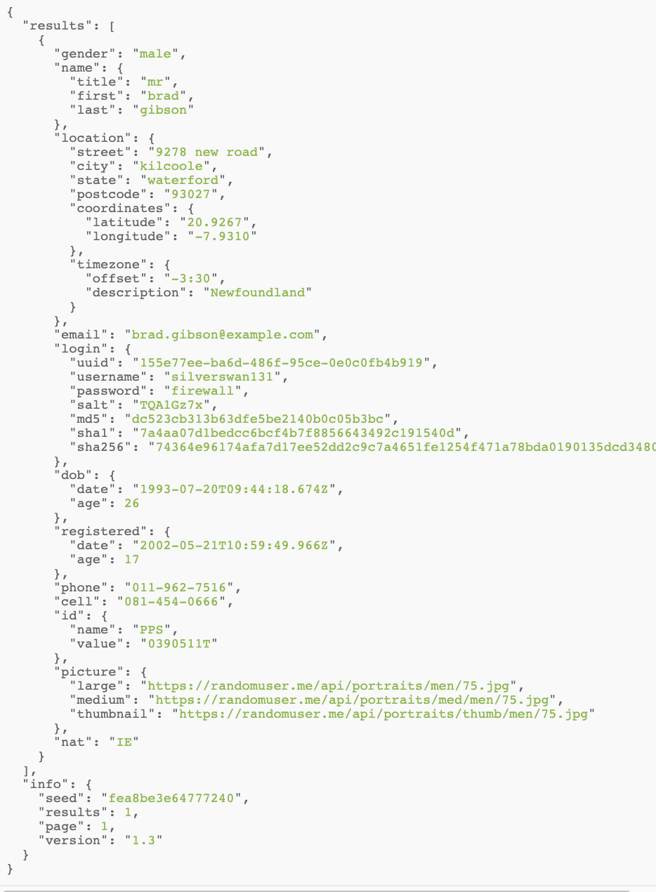

Official (Closed) - Non Sensitive
Let’s Code
JSON set information
Results set
#EXERCISE
10mins
Object Exercise
See repl.it Project :
AJAX Random user
JSON set information
Info set
https://developer.mozilla.org/en-US/docs/Web/API/Fetch_API/Using_Fetch
Continuing Education & Training (CET)
Notes:
https://replit.com/@modern-frontend/Taxi-Fare-While-Loop#README.md

Slide 66
Official (Closed) - Non Sensitive
PSI
#pollutionstandardindex
#hazeliterally
Continuing Education & Training (CET)
Notes:
Let’s work on something more complex like retrivig the PSI data from govsg

Slide 67

Official (Closed) - Non Sensitive
Source: https://data.gov.sg/
Continuing Education & Training (CET)

Slide 68
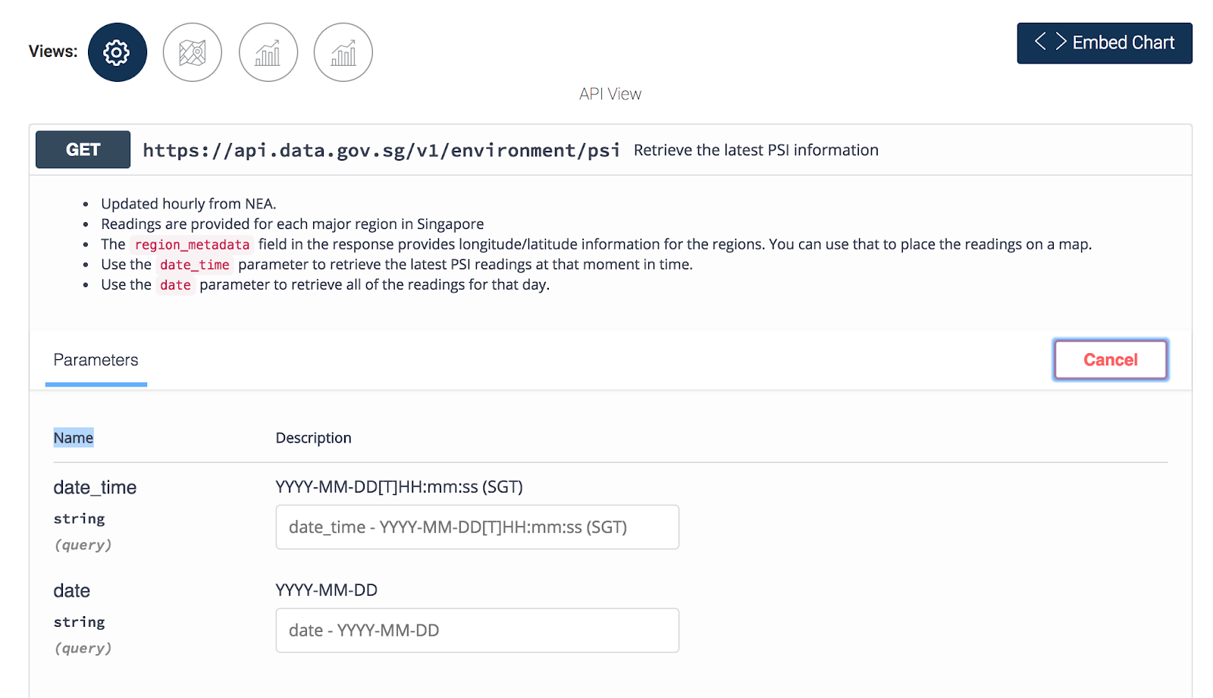
Official (Closed) - Non Sensitive
Source: https://data.gov.sg/dataset/psi
Continuing Education & Training (CET)
Notes:
Most APIs will document their API processes in their documentation.
From here, we can gather how to request for API data based on the API request settings.

Slide 69
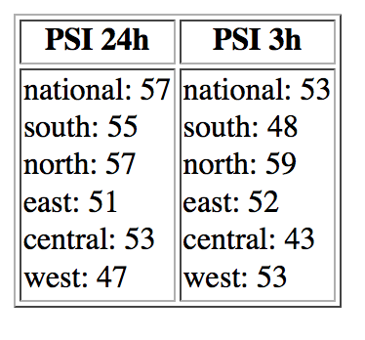
Official (Closed) - Non Sensitive
Let’s Code
#EXERCISE
10mins
Object Exercise
See repl.it Project :
AJAX PSI
https://developer.mozilla.org/en-US/docs/Web/API/Fetch_API/Using_Fetch
Continuing Education & Training (CET)
Notes:
https://replit.com/@modern-frontend/Taxi-Fare-While-Loop#README.md

Slide 70
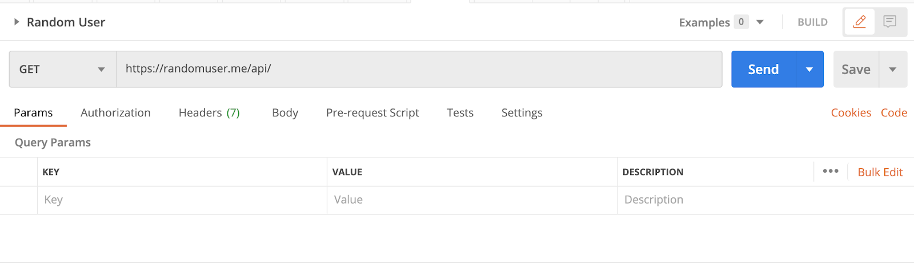

Official (Closed) - Non Sensitive
API
Key Takeaway?
Practise & Practise
It takes quite a bit of trial and error with APIs. Always test using POSTMAN first. This is to allow code to be tested first before you actually start coding it.
The POSTMAN code feature allows you to show the AJAX code for JS Fetch, jQuery and many more. Try it out :)
ID
Continuing Education & Training (CET)

Slide 71
Official (Closed) - Non Sensitive
Important Readings
AJAX
https://applyhead.com/xmlhttprequest-vs-fetch-api/
https://developer.mozilla.org/en-US/docs/Web/API/XMLHttpRequest
https://www.w3schools.com/jquery/jquery_ajax_get_post.asp
API Reference
https://www.programmableweb.com/
WATCH THIS: https://www.youtube.com/watch?v=7YcW25PHnAA
JSON Refresher
https://www.youtube.com/watch?v=wI1CWzNtE-M
https://www.youtube.com/watch?v=rJesac0_Ftw
Tools
http://crossorigin.me/
JSONView Chrome Extension
https://jsonformatter.org/
Animista.net (CSS Animation Tool)
Continuing Education & Training (CET)
Continuing Education & Training (CET)

Slide 72
Official (Closed) - Non Sensitive
READING
“Asynchronous” means that when a client requests data from a web server, it doesn’t freeze until the server replies. On the contrary, the user can still navigate the pages. As soon as the server returns a response, a relevant function manipulates the returned data behind the scenes.
“JavaScript” is the language which instantiates an AJAX request, parses the corresponding AJAX response, and finally updates the DOM.
A client uses the XMLHttpRequest or XHR API to make a request to a server. Think of the API (Application Programming Interface) as a set of methods which specify the rules of communication between the two interested parties. However, note that the incoming data from an AJAX request can be in any format and not only in XML format.
Continuing Education & Training (CET)

Slide 73

Learning Above Event Callbacks
Official (Closed) - Non Sensitive
READING
https://www.youtube.com/watch?v=8aGhZQkoFbQ&vl=en
Continuing Education & Training (CET)
Notes:
https://www.youtube.com/watch?v=8aGhZQkoFbQ&vl=en

